Slide 1
Canvas
Team: JABAS: Jane, Alisha, Brian, April & Savita

Slide 2
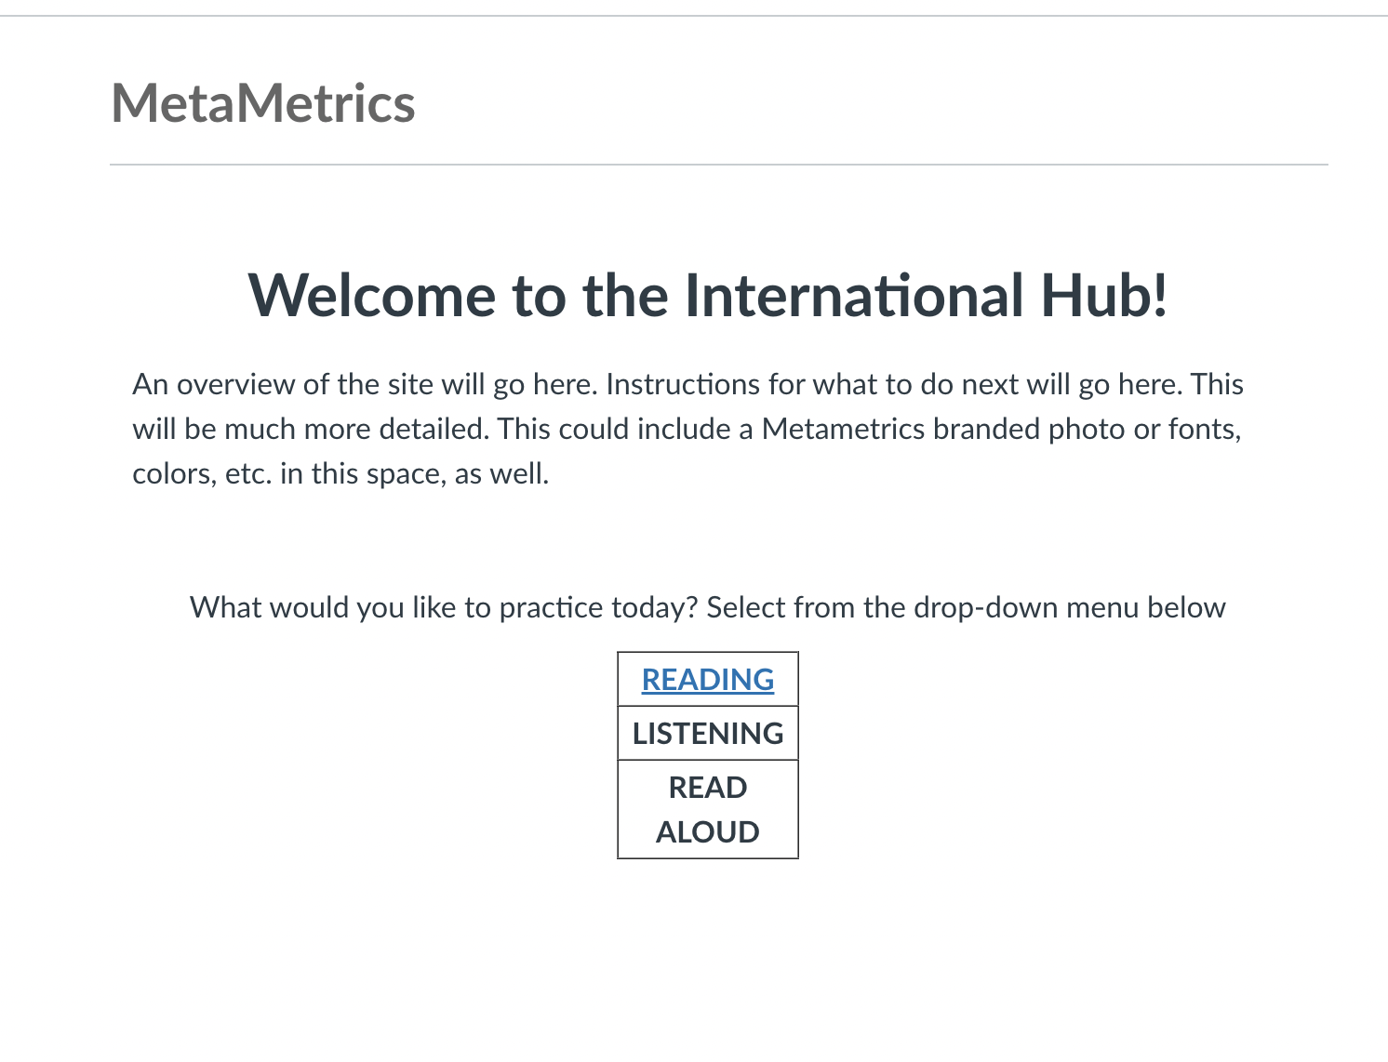
NOTE: Metametrics branding can be added to this home page
This would be a drop-down menu, but as of now, there is no way to incorporate that without a plug-in.
Notes:
Separating by construct allows them to determine HOW they want to practice

Slide 3
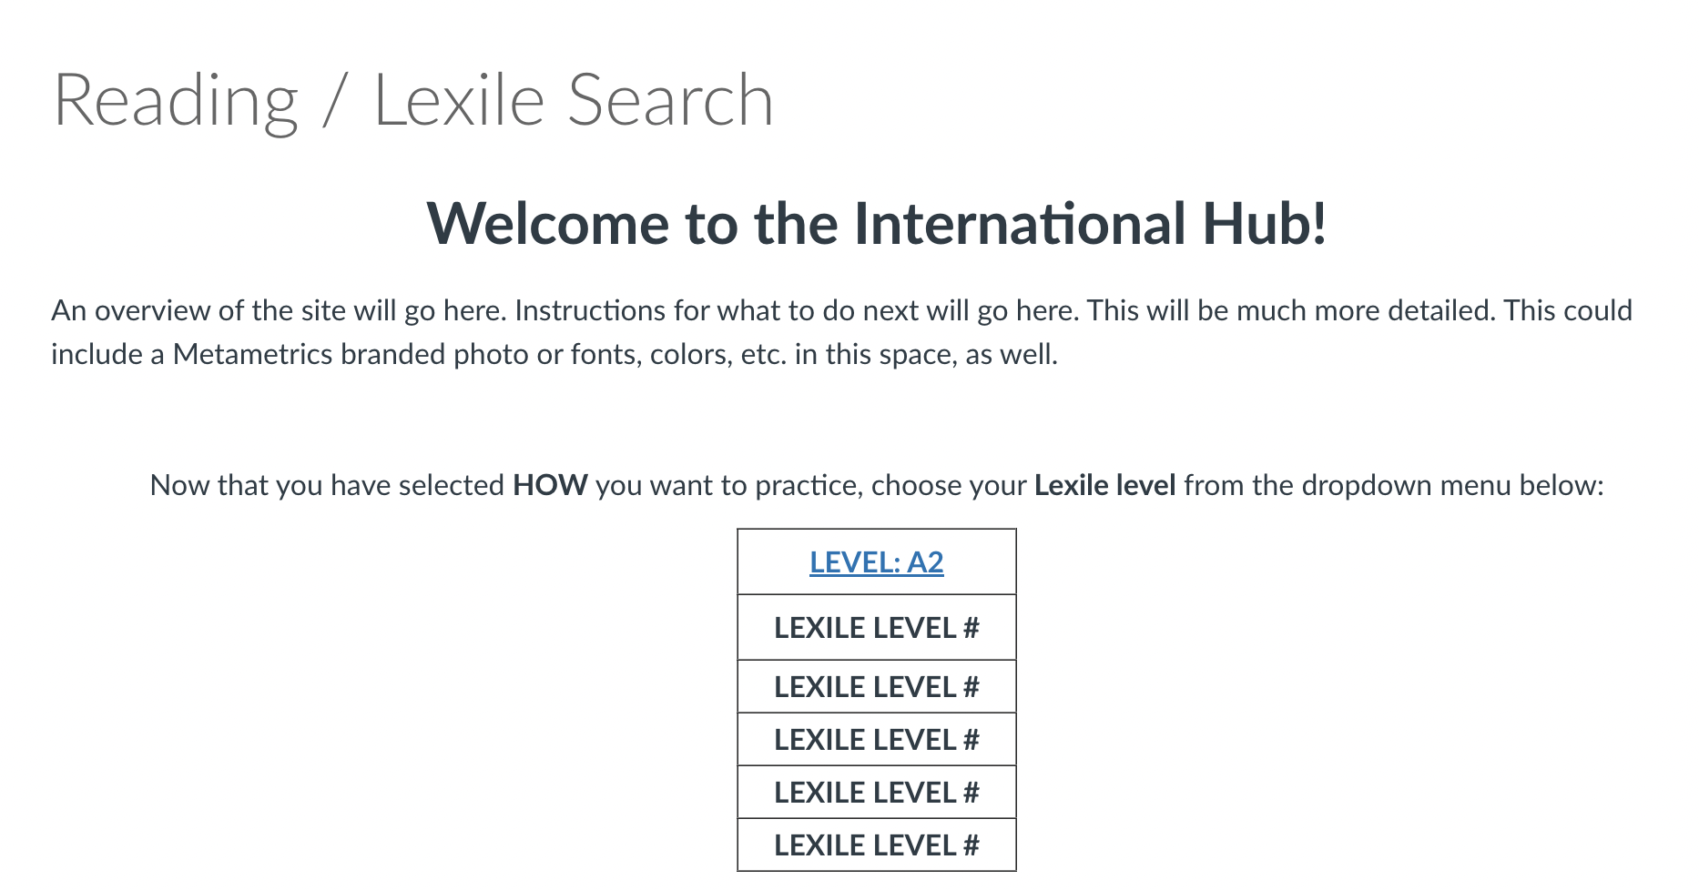
CHALLENGE: There is no way to keep uniform title at the top of the page and only change portions of the text below.
Users would click on their level in the menu
This text would remain the same, and only the information below would change.

Slide 4
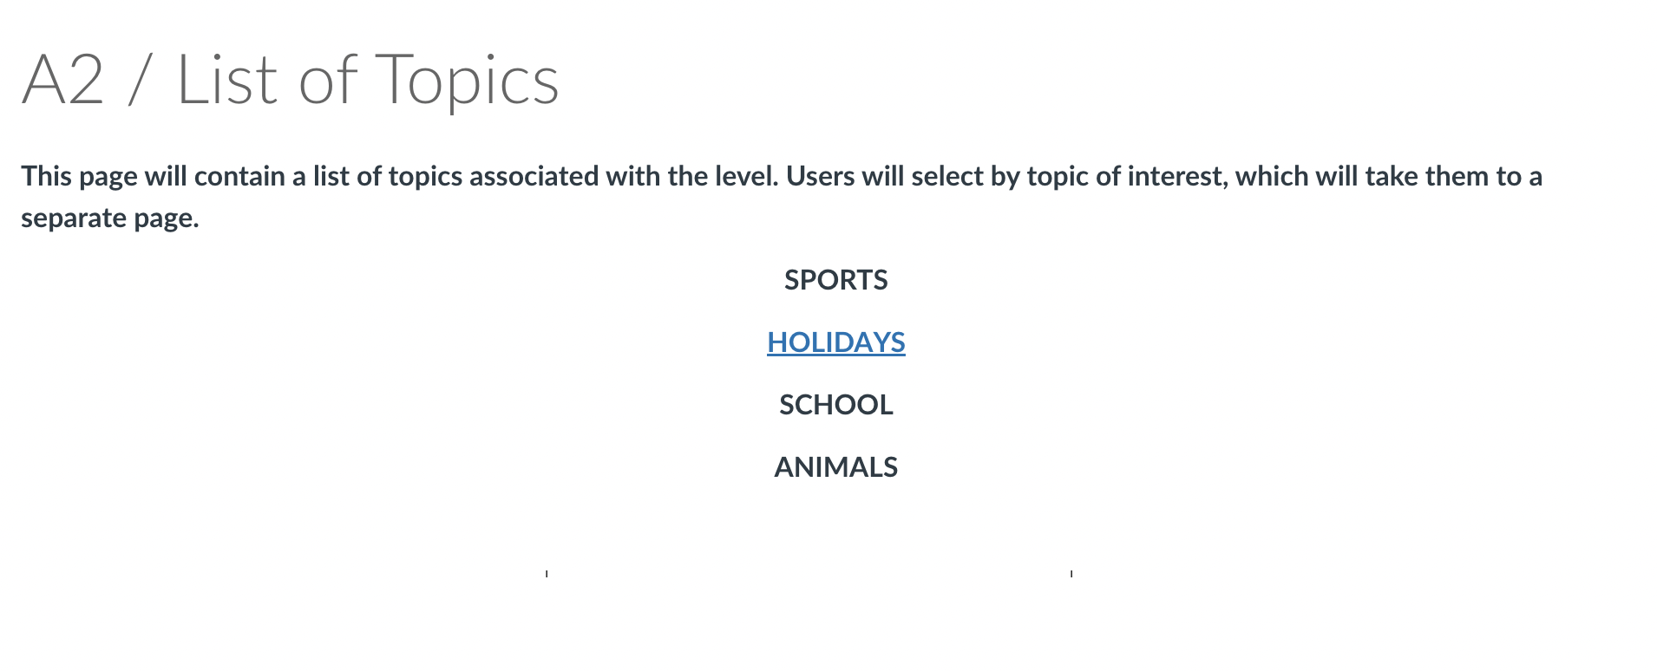
After landing on the level page, users can select from topics of interest. The “interests” could be buttons, images, etc. to make it more inviting.
Notes:
VERSION 1 CONS: It doesn’t tell the users anything about what they will be reading, and currently this only links out to ONE story each. It might be better to link by Lexile level FIRST (and delete the construct sections), then take the students to a set of reading vs listening vs read aloud sections

Slide 5
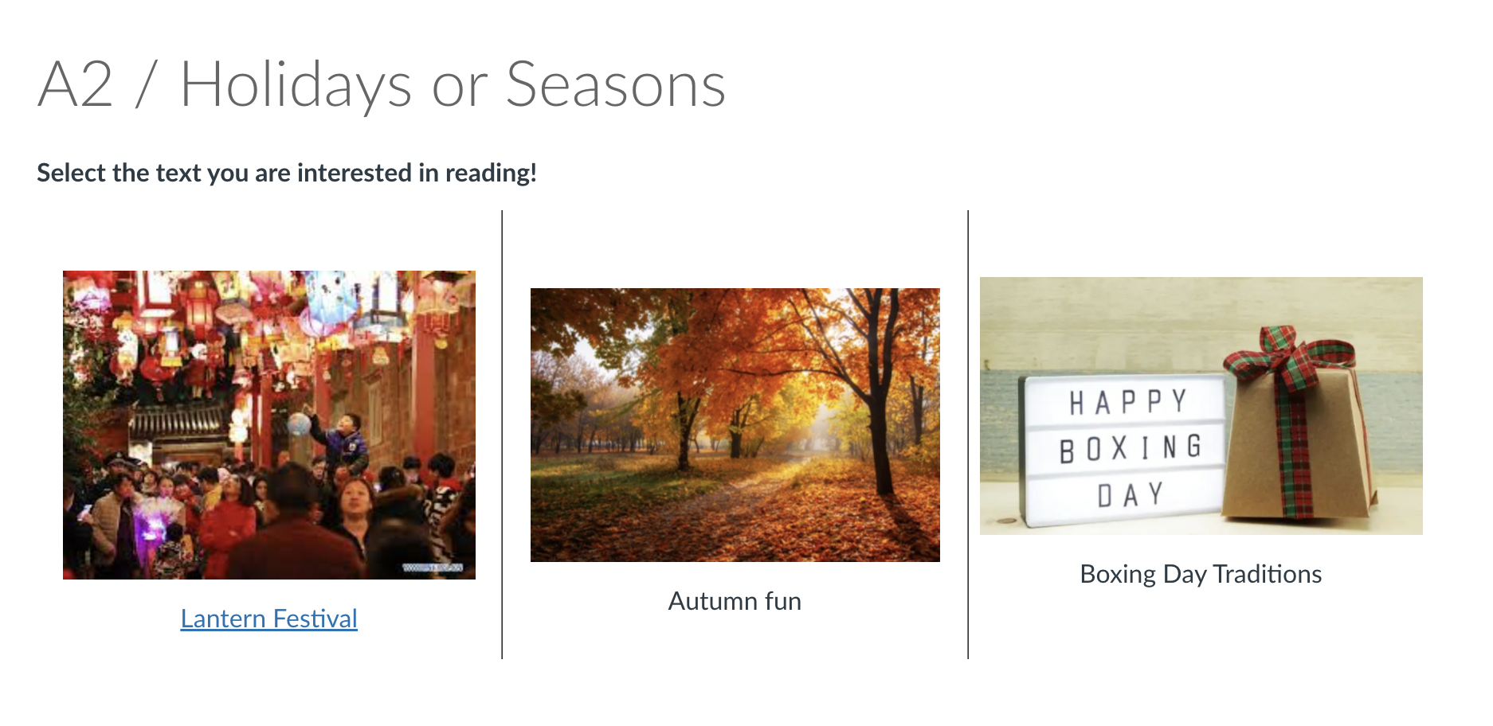
Interest from previous page would appear here, along with Lexile level
Both the image and title are linked and will take students to that text
Notes:
CONS: Cannot seem to hide middle borders. Alignment is very difficult because when you insert the image, it does not automatically resize to match the image adjacent to it

Slide 6
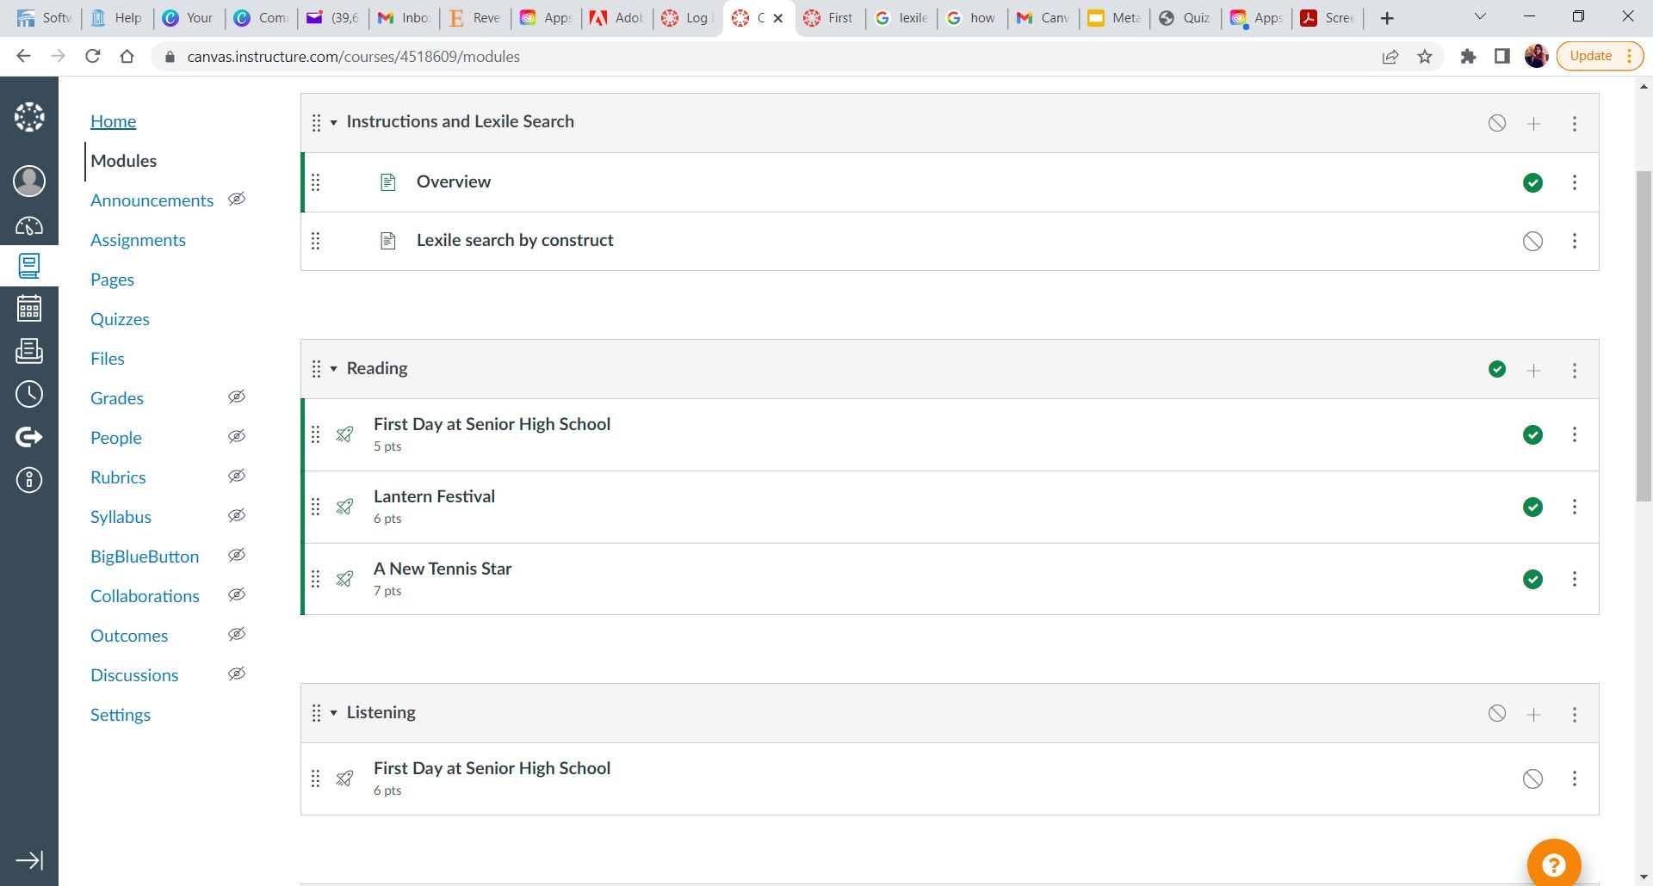
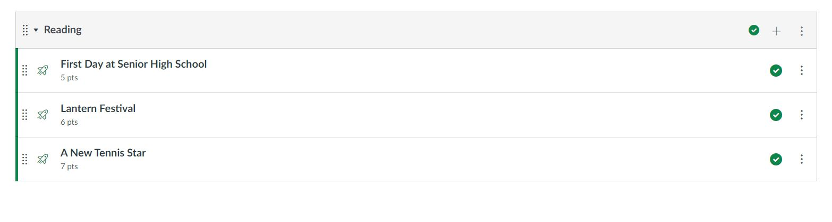
Reading

Slide 7

Reading - Overview & Positives
Several question types to choose from
Easy to indicate one correct answer
Can easily manipulate order/grouping of questions
Can insert ‘text only’ anywhere in quiz format
Quiz format seemed to help consolidate items

Slide 8
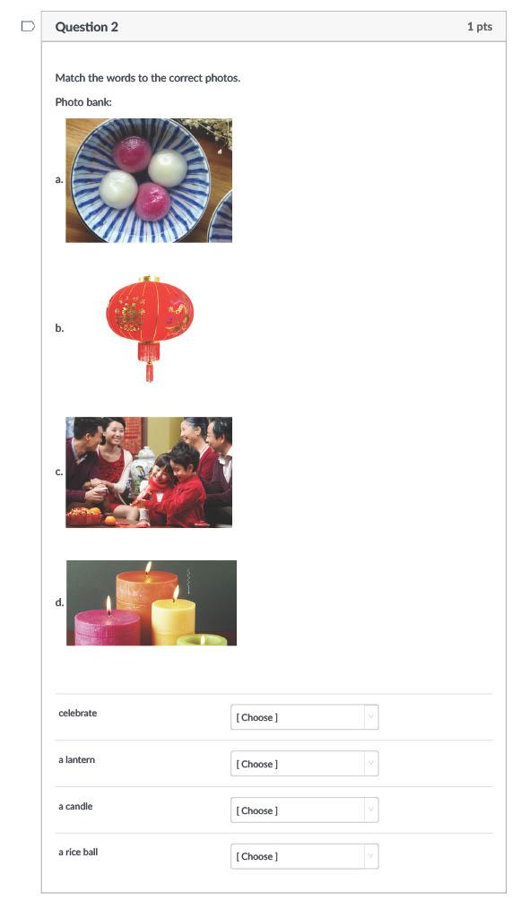
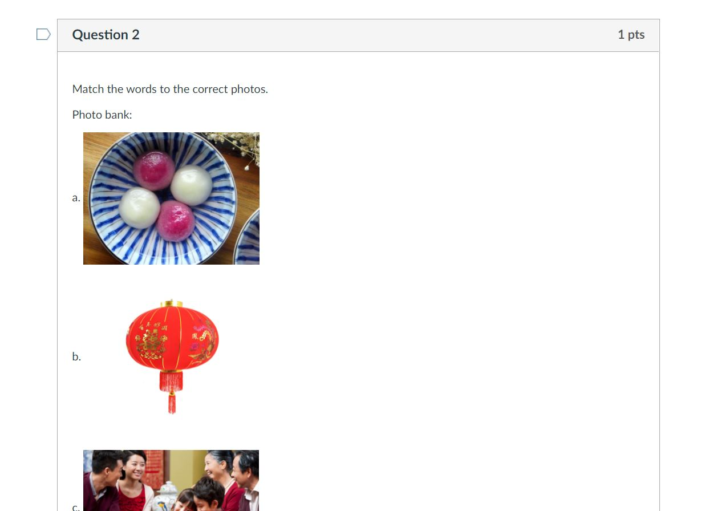
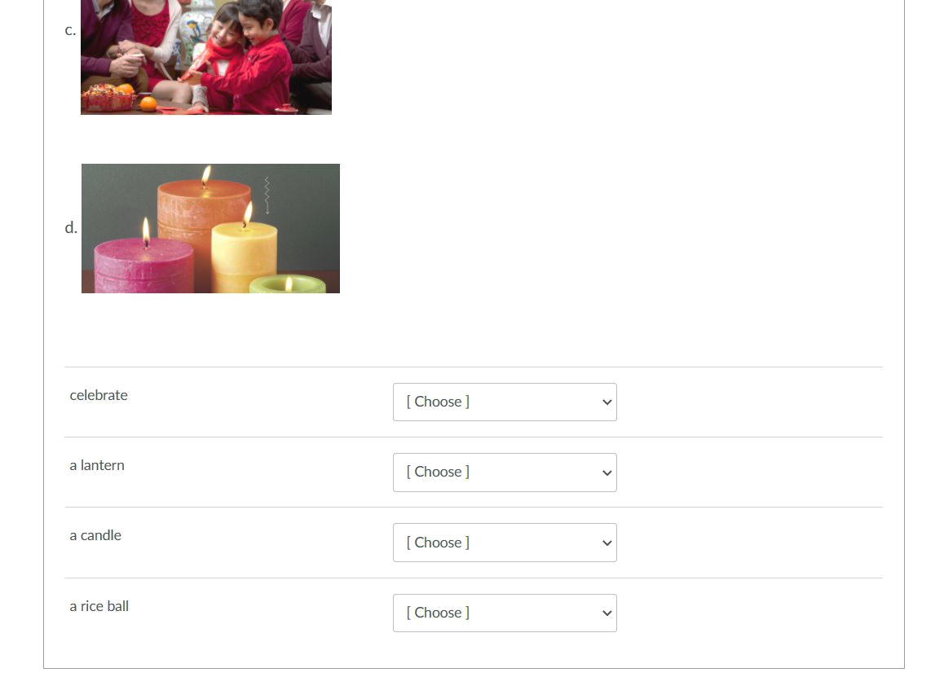
Reading - Challenge with matching questions
Unable to add pictures/media as answer choices

Slide 9
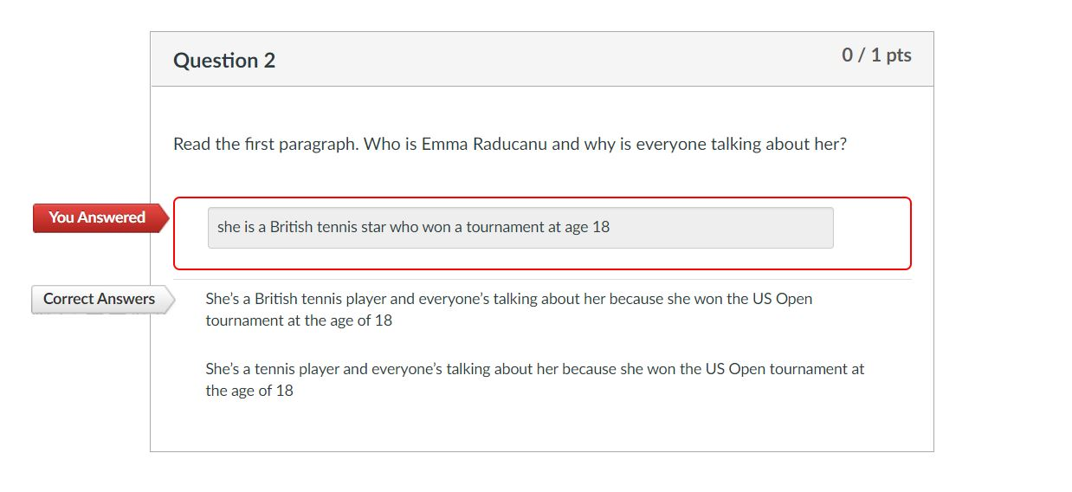
Reading - Challenge with short answer
Possible variation not accepted
Answer key provided by MetaMetrics document
Possible answer choice added to answer key

Slide 10
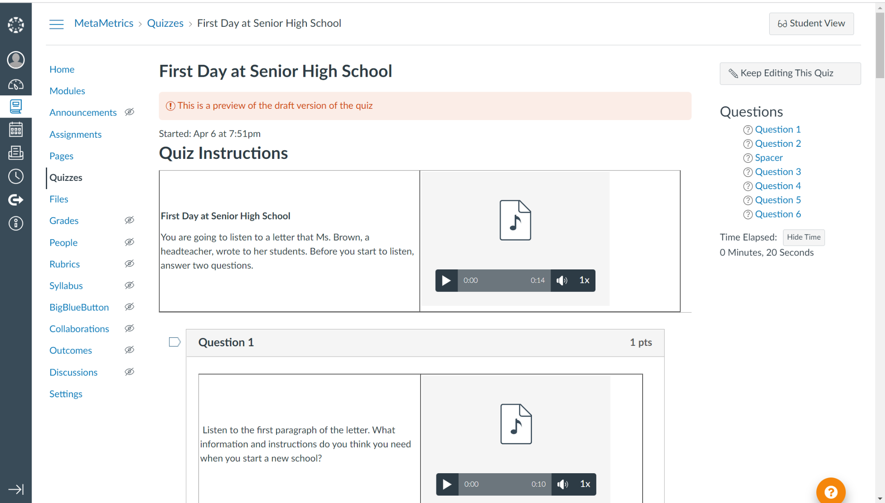
Listening
Multiple types of files within the instructions and question description
Ability to add instructions
Notes:
Alisha: I worked on the listening section for Canvas. In creating this quiz, I encountered some particular strengths and weaknesses in the quiz design and functionality of Canvas
Ability to add instructions in multiple places
Multiple types of files allowed in the instruction and question description
Used a table in order to make sure the text and the audio file are close to each other (you can scale the audio file, but then it will not show th play button, students would have to click on the icon itself)

Slide 11
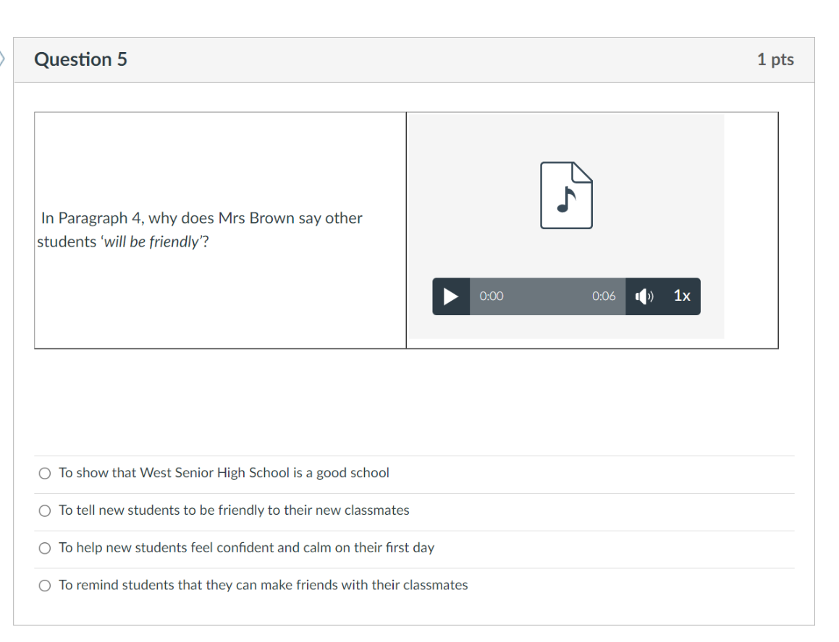
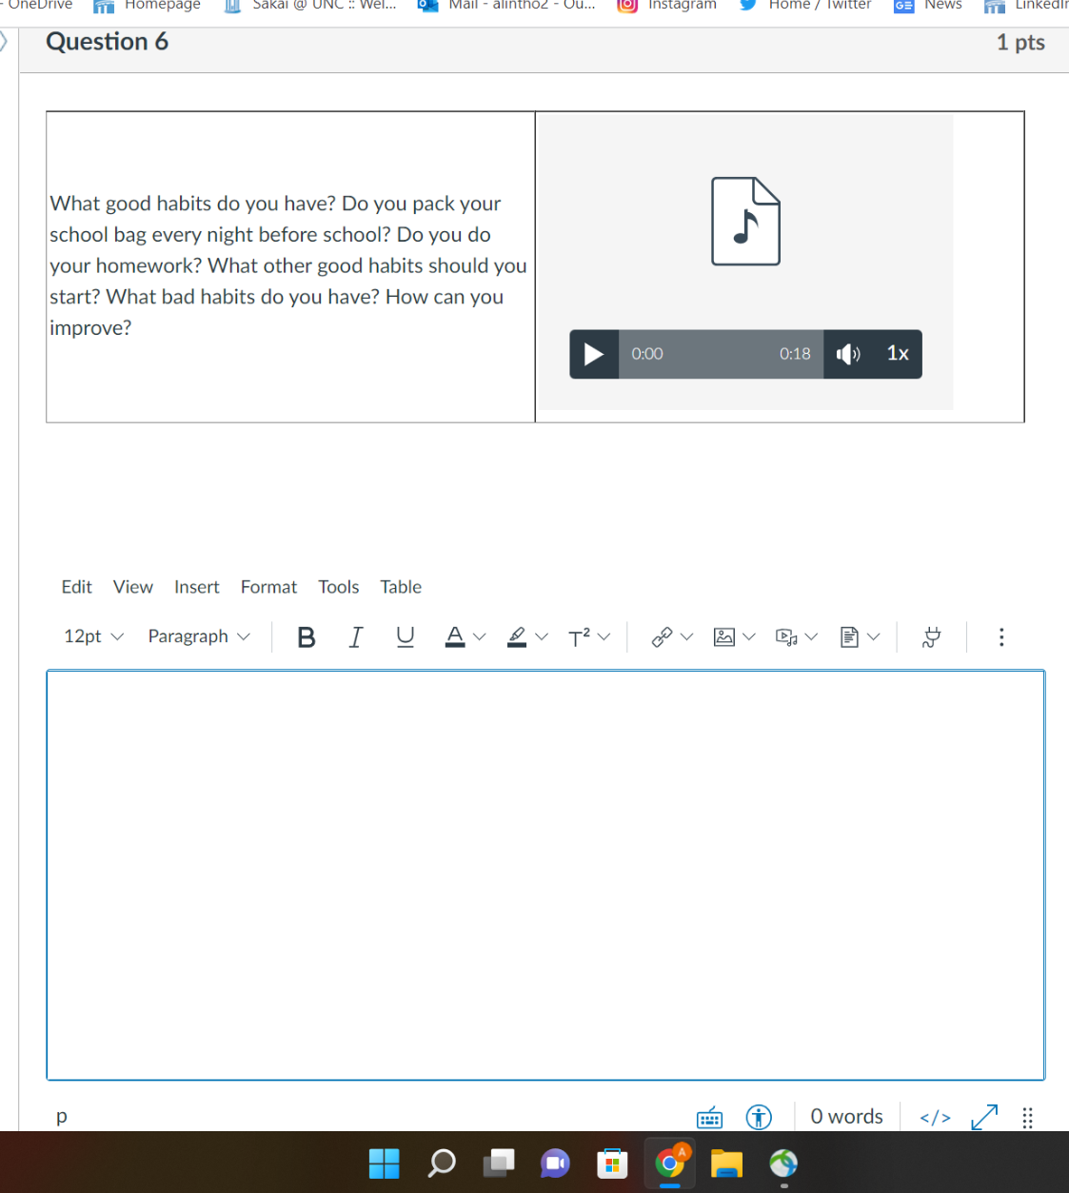
Multiple choice
Essay
Notes:
Creating the multiple choice and essay questions was straightforward and easy

Slide 12
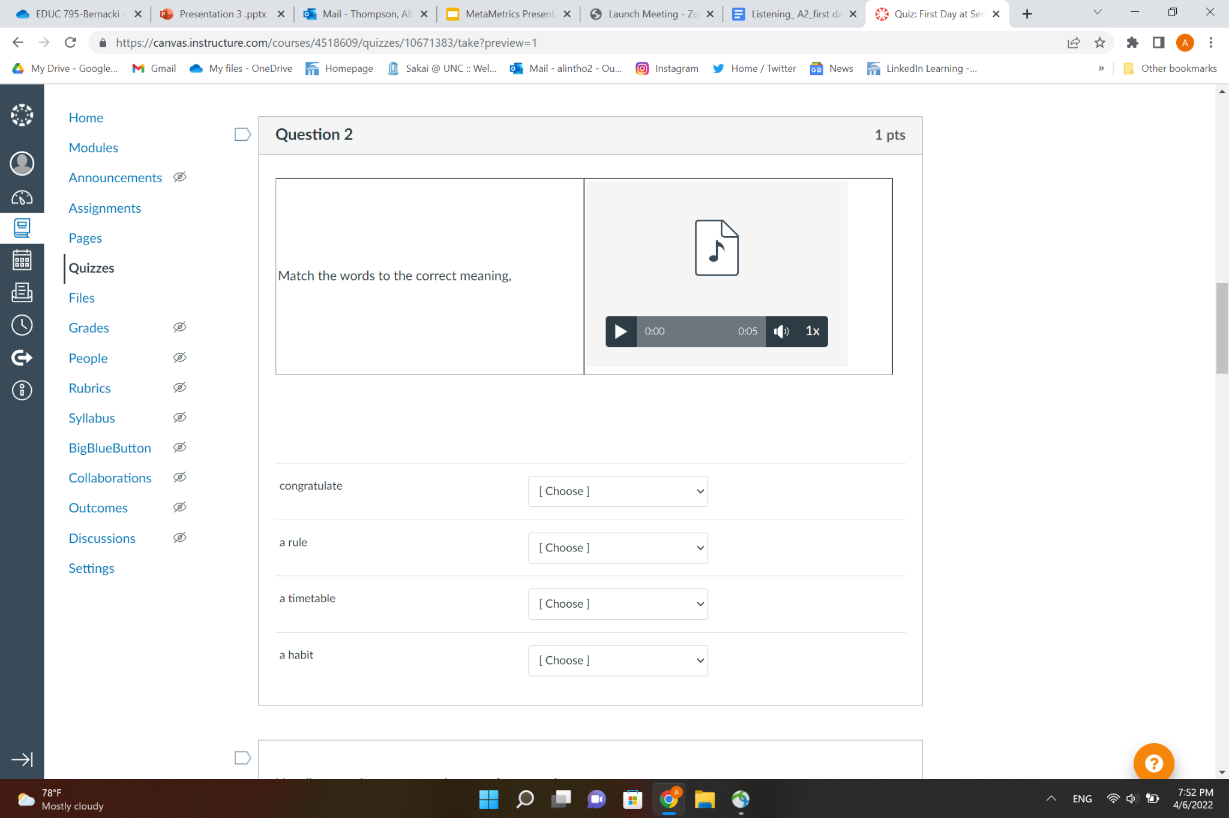
Challenge in adding media in the question / response setion
Notes:
However, in this slide, you will see a matching question within my quiz. You will still see how a student can listen to the instructions, but this page shows one of the main challenges of the listening quiz
As you all know, the listening section in MetaMetrics has audio files for the question and answer responses. However, in Canvas, you cannot add any media to the question and answer section. You can only add media in the description.

Slide 13
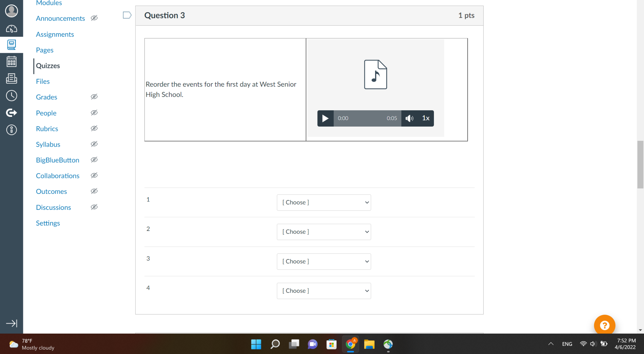
Challenges with ordering type questions
Possible solution with Canvas New Quizzes
Notes:
The last particular difficulty I want to mention is the creation of ordering questions. In this example, students have to put the events in order based on the listening. This question type was not available in the Canvas platform that we worked with, but I did some research and it seems that this is possible with Canvas New Quizzes.
New Quizzes is a quiz engine that integrates with Canvas as an LTI tool and replaces the classic quizzes functionality currently existing in Canvas. It is not available in a test environment, but if MetaMetrics were to use Canvas as their LMS, there is the possibility of added quiz functionality

Slide 14
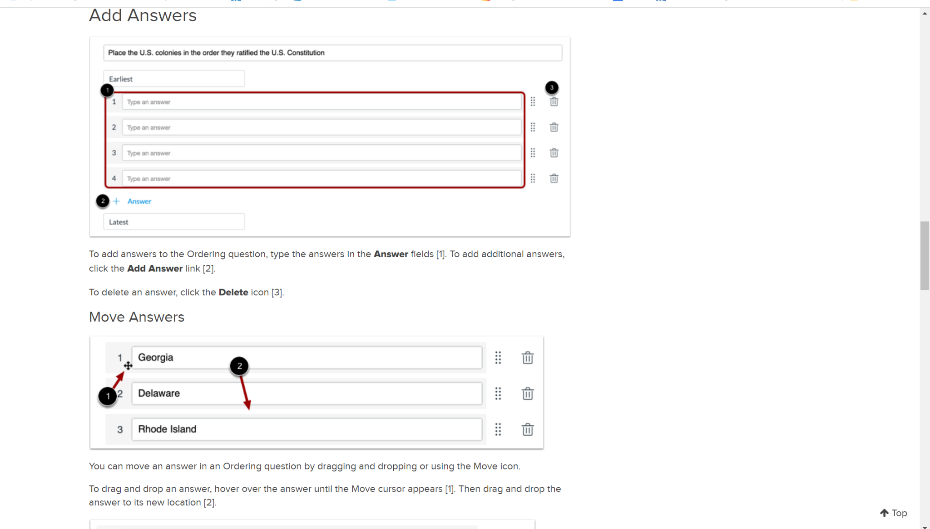
Image Credit: Canvas Community
Notes:
Alisha: In this picture taken from the Canvas Community, you can see what this type of question could possibly look like. Students would use their cursor to move the response items in the correct order.
April is now going to speak to the experience of prototyping the read aloud section

Slide 15
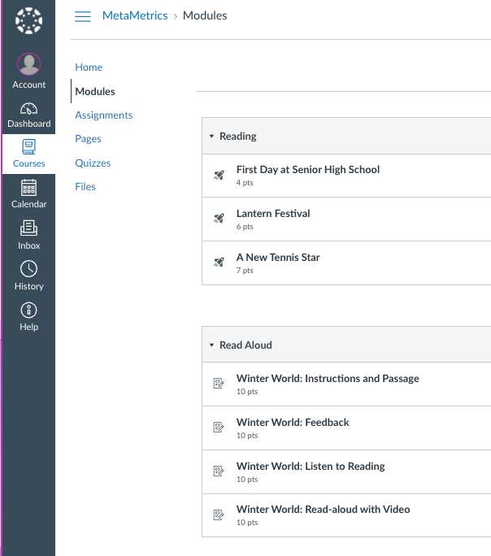
Read-aloud
Instructions and passage with mp3
Listen to reading
Feedback
Read-aloud with video
Notes:
April: This is an overview of the dashboard. Under modules-set up as assignments (was pages) Using the Winter World assignments, we will focus on…

Slide 16
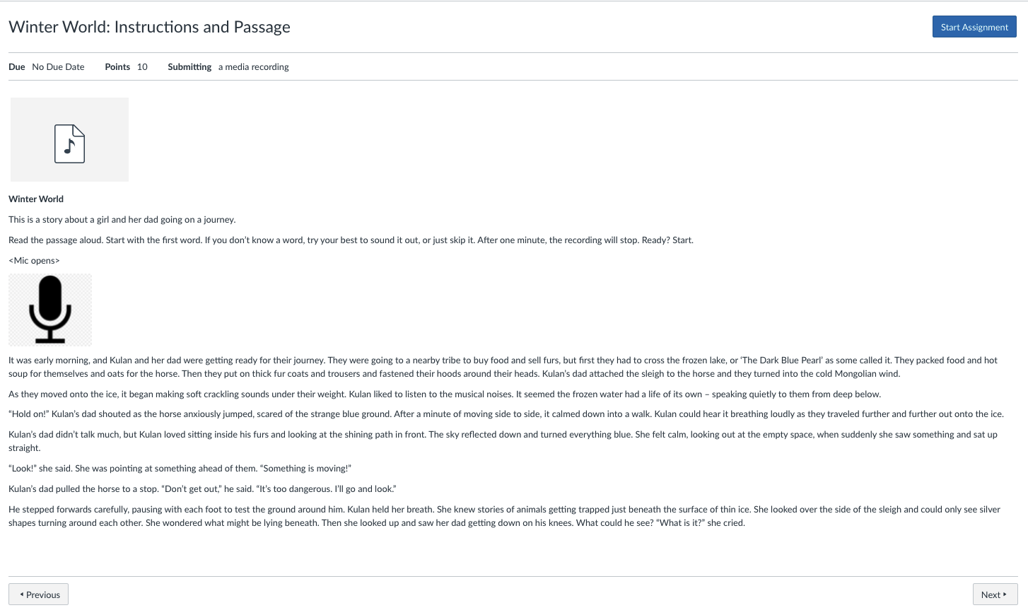
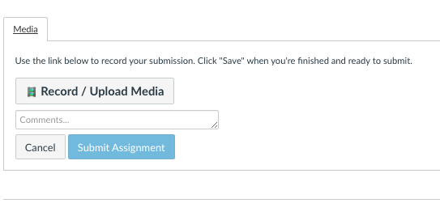
Audio file: instructions
Ideally, the mic would be here, not in the start assignment button
After selecting start assignment-recording/listing tool appears
Notes:
April: After clicking into WW instructions and passage assignment-after selecting “start assignment” takes you to the next section…

Slide 17
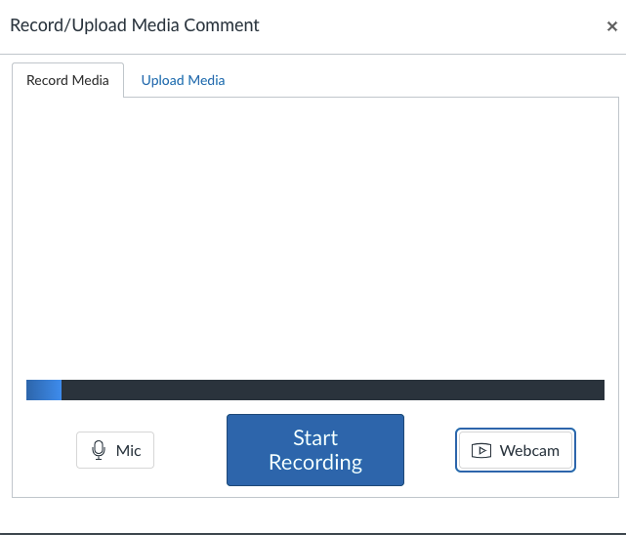
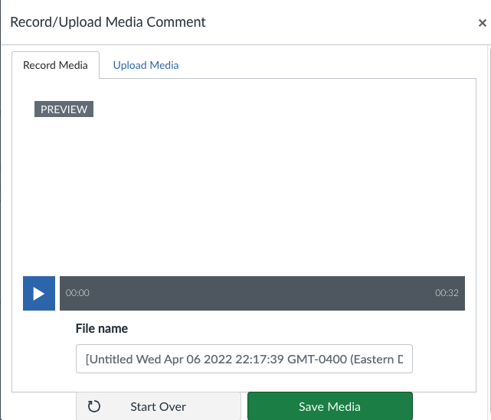
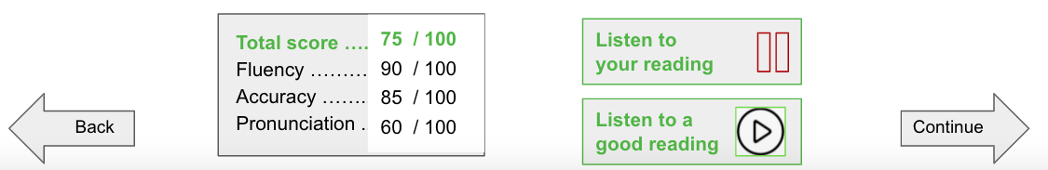
Will need a scoring & reporting tool added to page
No ability to listen to good reading in this format.
Notes:
April: After clicking into start assignment, the record/upload window appears. Here’s a larger version of the media content window from the last slide. A student can turn on/off webcam, hear their fluency, save media and start over-

Slide 18
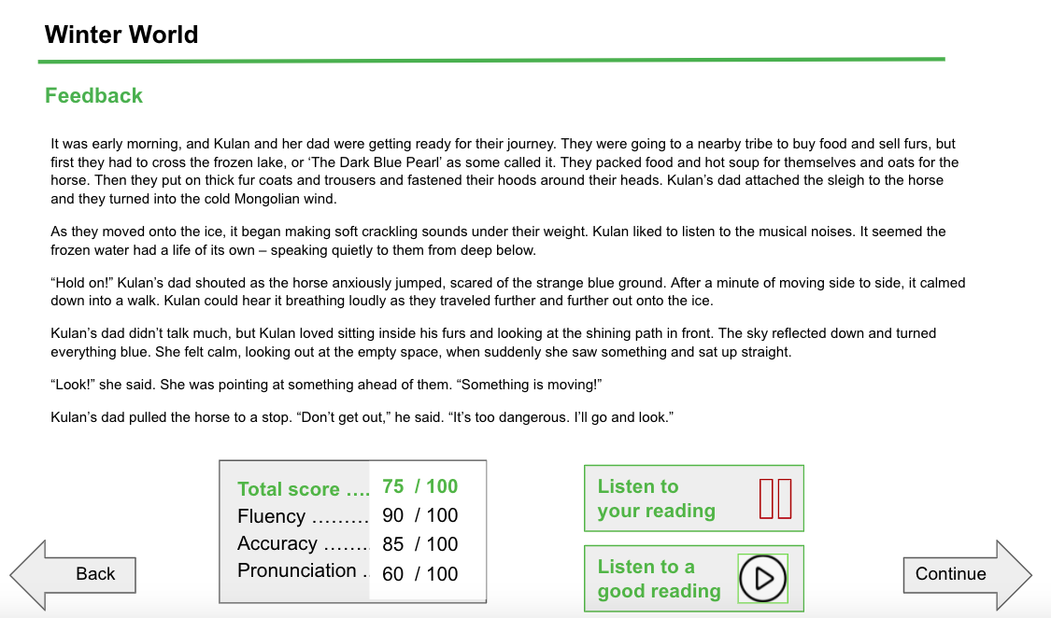
Notes:
April: This would be a cleaner layout

Slide 19
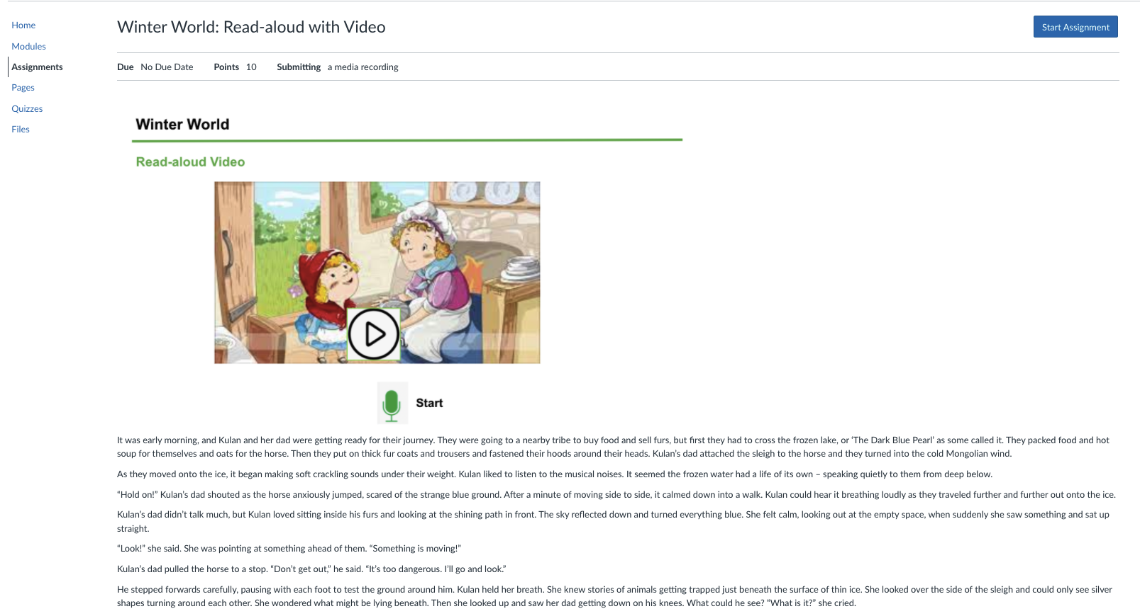
Ideally, the mic would be here or imbedded into the video-not in the start assignment button

Slide 20
User Experience- Pros
Links to other pages for student use (Media, Make-up work, Docs connected to Google Drive, ect)
Dashboard choices for locating lexile levels and course topics were conveniently located
New Canvas Quizzes are a better option for order type questions.
The ability to finding class assignments, and using audio files for read aloud were easy to locate.

Slide 21

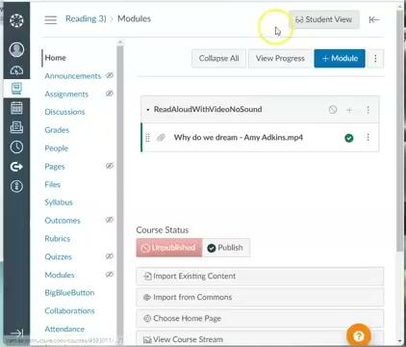
User Experience-Cons
Loading content sizing and alignment
System glitches could come from Canvas LMS design for the chrome browser
Any section not working properly including no audio for read aloud or any video issues will be skipped by the student.
Any student assignments not saved will be lost
Listening to good reading not available and help assistance does not cover the topic

