Slide 1


Executive Functioning Skills for High School Students
Brian Barrett- 2022 UNC MEITE Learning Engineer

Slide 2
Outline
The Problem
The Result
What is Think Bank?
What Makes it Unique?

Slide 3





Mental Preparation for Academic Success
This Photo by Unknown author is licensed under CC BY-NC-ND.
This Photo by Unknown author is licensed under CC BY.
This Photo by Unknown author is licensed under CC BY.
Notes:
Frequently late for class
Unorganized desk or bookbag missing supplies
Unable to pay attention & focus

Slide 4
82%
High school graduation rate
8%
Ready to take on college level courses
60%
I'm not ready
Results
OUTCOMES
https://studybreaks.com/college/college-3-2/

Slide 5
What is it?
Notes:
Ten module cognitive skills course for high school students. The Think Bank is a reintroduction of cognitive skills lost or underdeveloped to hep students in their attitudes toward academic success and positive peer interaction.

Slide 6
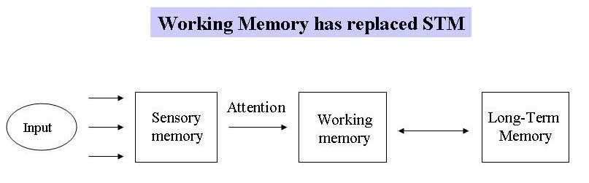



The Think Bank: Learning Outcomes
1
2
3
Notes:
Learning Objectives using the working memory as a framework
1. Recall the information presented using executive functioning skills to develop mental connections to complete academic work.
2. Apply executive functioning skills to building a foundation for accomplishing academic work and social interaction.
3. Use the executive functioning skills in current learning environments and other social settings.

Slide 7
(Short Term Memory)
Engaging Exercises
Module Assessments
Writing Reflection
Discussion
Prompts
1-3 seconds
Baddeley & Hitch, 2014
Notes:
All activities are designed to pass the sensory memory and attention to focus on the students working memory: Explain

Slide 8

Example-Recall
Engaging Exercises
UNIQUENESSS
100-word reflection prompt
Notes:
Example of module assignment giving students a choice in deciding how to complete the assignment (Owners) using their creativity
Several resources are provided to complete the tasks in the module
Students learn definitions, connected to images and reflect on their completion of tasks with peers.
Students also have a 100 word writing prompt reflecting on the information

Slide 9



Target Audience
This Photo by Unknown author is licensed under CC BY-SA.
This Photo by Unknown author is licensed under CC BY.
This Photo by Unknown author is licensed under CC BY.
Notes:
Course will be sold to educational organizations or associations
1. Secondary schools who can create innovative ways to help struggling students. Freshman Academy, New Student Orientation or as independent skills for students with developmental disabilities.
2. Education departments that instruct students in soft skills for academic success non-academic content a part of learning
3. Non profit organizations who help students outside the classroom. Ie Community in Schools

Slide 10
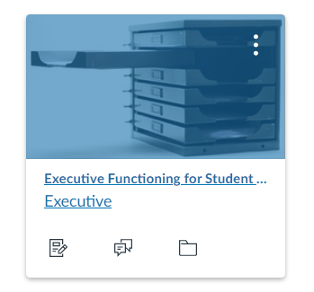
Course Availability / Cost $$$$
Subscriptions with 10-24 seats will receive a 5% discount.
Subscriptions with 25-49 seats will receive a 10% discount.
Subscriptions with 50-99 seats will receive a 15% discount.
Subscriptions with 100 or more seats will receive a 25% discount
Notes:
Course can be found on Canvas and will be available by access on The Think Bank website. Organizations will able to purchase this course and others by a bundled package requiring a 1-3 years subscription renewal. Cost will be NEG based on length of subscriptions, total number of users, and need for coaching instructors to accurately administer the course.

Slide 11




"Relevant Skills for Student Empowerment"
This Photo by Unknown author is licensed under CC BY.
Notes:
Students are assessed by completing exercises, writing prompts, discussion prompts (provides feedback) and formative assessments. The course empowers students to own their success.

